Slide 1
MICROSOFT MOVIE ANALYSIS
DIANA JERUSHA OLULO
FEBRUARY 2 2024

Slide 2
Summary
Microsoft would like to start a movie studio and is interested in what makes a successful film. In this project we focused on several aspects of the film industry including:
Popularity among diferent genres.
Average runtime among diferent movies.
Amount of worldwide gross generated by different genres

Slide 3
Outline
Bussiness Problem
Data and Methods
Results
Conclusions

Slide 4
Business Problem
Microsft producers need help starting up their movie studio. Below are a few ideas that will lead Microsoft to having a successful movie studio:
Duration of a movie should fall with the optimal runtime.
Use production budget as a prediction of how much a movie will gross worldwide.
Production budget should fall within the range of 15 to 30 million dollars.
Produce genres with the highest popularity and ratings.

Slide 5
Data and Methods
We used data provided to us to create unique and effective visualizations that will help explain the path that we believe Microsoft should follow.Below is the data we used to conduct our analysis:
imdb_title_basics
tn_movie_budget
tmdb_movies
We then used seaborn and matplotlib to create visualizatiions that are key

Slide 6
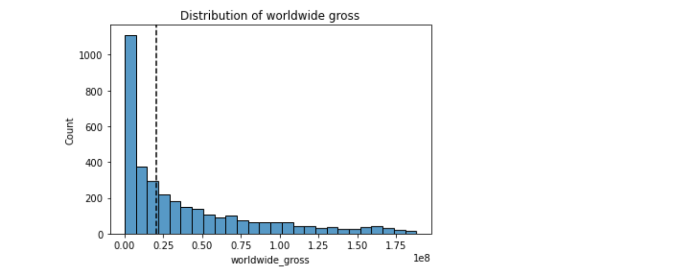
Results
The graph also includes a cumulative distribution line that shows the percentage of movies that have a worldwide gross below a certain amount. For example, approximately 75% of movies have a worldwide gross below 200, while 95% of movies have a worldwide gross below 400.

Slide 7
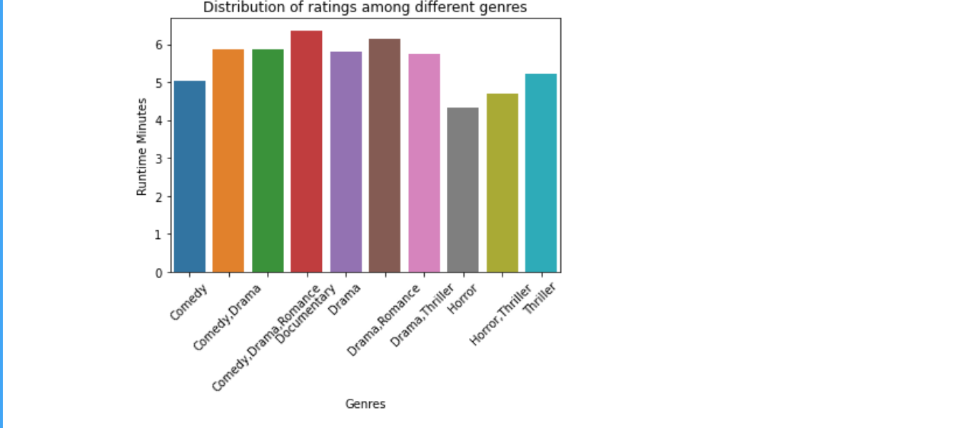
Results
The graph below depicts that the Action genre yields the highest revenue, around 1.25 billion dollars, followed by Comedy, Drama, and Adventure genres with revenues of approximately 750 million, 500 million, and 400 million dollars respectively.

Slide 8
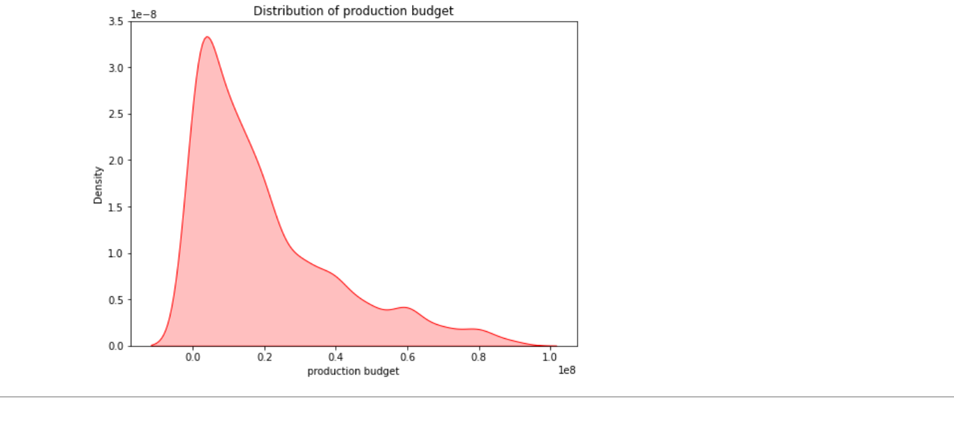
Results
Based on the graph, we can observe that most movies have a production budget between 0 and 30 million dollars. The peak of the density plot is around 15 million dollars, indicating that this is the most common production budget for movies in the dataset. The graph also shows that there are some movies with very high production budgets, with a few movies having budgets of over 100 million dollars.

Slide 9
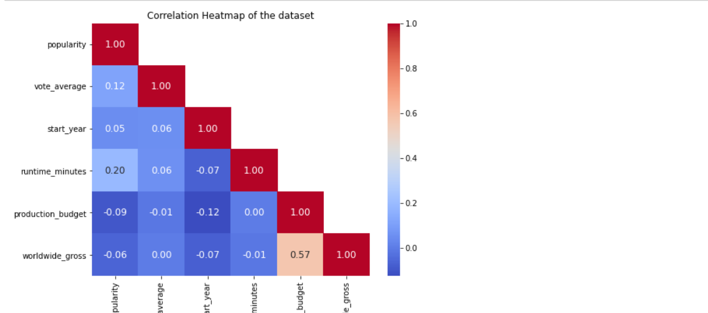
Results
The heatmap reveals significant correlations: popularity and worldwide gross (0.57), larger budgets and higher gross (0.41), while longer runtimes tend to slightly lower vote averages (-0.12). This suggests focusing on popular genres with moderate budgets for optimal returns.

Slide 10
Conclusion
The analysis leads to the following recommendations:
Microsoft should aim for movie runtimes between 90 and 125 minutes.
The production budget should fall within the range of 15 to 30 million dollars.
Microsoft should prioritize producing more comedy, drama, action, and adventure movies, as they are popular and generate high revenue.

Slide 11
Thank You
Email: dianaolul0@gmail.com
GitHub: Dee-Olulo
Github url: https://github.com/Dee-Olulo

